Slide 1
SOF 103
C and C++ Programming
Chapter 2
Simple Variables and Data Types
Compiled by Dr. Hew

Slide 2
Vision and Mission
Vision
Xiamen University Malaysia aspires to become a university with a distinct global outlook, featuring first-class teaching and research, and embracing cultural diversity.
Mission
To nurture young talents with dignity and wisdom, turning them into fine citizens of the region who will contribute to the prosperity of the people and social progress of Malaysia, China and Southeast Asia.
Compile by Dr. Hew

Slide 3
Enrollment Key
ilove SOF103
Compile by Dr. Hew

Slide 4
Last week review
The program consist of four parts:
The pre-processor.
The namespace.
The main function block.
The statements.
To be discussed later
# include < iostream> using namespace std; int main ( ) { cout << “Welcome to C++” ; return 0; }
Compiled by Dr. Hew

Slide 5
Last week review
The main function block
A C++ program always run from the first line to the last line.
One program, one main function
- A pair of { }
Compile by Dr. Hew

Slide 6
Last week review
The statements
There are always some statements in the main function.
- The computer executes the first statement, then the second, then the third…
return 0; is a statement.
- Each C++ statement is ended with (;)
Compile by Dr. Hew

Slide 7
Last week review
cout and <<
cout is the pre-defined object for console output, in this case a computer screen.
- The insertion operator (<< )marks the direction of data flow. This also can be used to concatenate multiple data streams in one single statements.
“Welcome to C++” is a string
Characters reside in “ ” form a string
Each C++ statement is ended with (;)
Compile by Dr. Hew

Slide 8
Last week review
# include < iostream> using namespace std; int main ( ) { cout << “Welcome to C++ \n” ; return 0; }
Compiled by Dr. Hew

Slide 9
Chapter Overview
Variables, constants and assignment statements
Data types
Arithmetic operators
Input statement
Operator precedence

Slide 10
Variables
A storage location in computer’s memory
A variable is a container that stores a value.
Once we declare a variable, the system allocates a memory space for it, then we may store a value in that space.
In C++, each variable must have a data type.
  It tells the system how to allocate memory space.
  It tells the system how to interpret the 0s and 1s
1. Variables, Constants, and Assignment Statements

Slide 11
Identifiers
Variables names are called identifiers
Choosing variable names
  Use meaningful names that represent data to
  be stored. For example, “studentGrade”, “studentMarks”, etc.
Identifier Rules:
  The first character of an identifier must be an alphabetic character or an underscore ( _ ).
  After the first character you may use alphabetic characters, numbers, or underscore characters.
  Upper and lowercase characters are distinct/different.
  Special characters are not allowed to be used.
  Keywords cannot be used as an identifier.
1. Variables, Constants, and Assignment Statements

Slide 12
Literals
  A literal is a value that is written into a program’s code.
  "hello, there" (string literal)
12 (integer literal)
Variable Definition
    int number;
  Variable Initialization
    number = 5;
  You can also write the above two statements as:
    int number = 5; //variable declaration & initialization
1. Variables, Constants, and Assignment Statements

Slide 13
Valid and Invalid Identifiers
IDENTIFIER | VALID? | REASON IF INVALID
totalSales | Yes
total_Sales | Yes
total.Sales | No | Cannot contain .
4thQtrSales | No | Cannot begin with digit
totalSale$ | No | Cannot contain $
1. Variables, Constants, and Assignment Statements

Slide 14
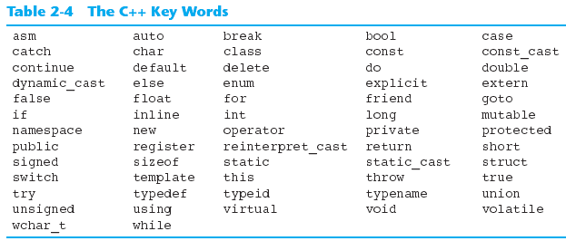
C++ Key Words
You cannot use any of the C++ key words as an identifier. These words have reserved meaning.
1. Variables, Constants, and Assignment Statements

Slide 15
Variable declaration
We must declare the variable by specify its name and type before we use it.
Syntax:
  data_type variable_name;
Example:
  int myNumber;
A variable name is an identifier.
Address | Identifier | Value
0x12ed2D | myNumber | ?????
1. Variables, Constants, and Assignment Statements

Slide 16
Assignment Statement
The expression on the right-hand side of the equal sign is evaluated first, and the result is then assigned to the variable on the left-hand side.
Syntax:
  Variable = Expression;
Examples
  distance = rate * time;
  count = count + 2;
1. Variables, Constants, and Assignment Statements

Slide 17
Declaration and Initialization
Beside declaring a variable, we may also assign a value to a variable.
  int myNumber;
  myNumber = 100;
We may do these together. The
assignment is called initialization.
Without initialization, the variable may be of any value ( depending on was left since the last time this space is used).
Address | Identifier | Value
0x12ed2D | myNumber | 100
1. Variables, Constants, and Assignment Statements

Slide 18
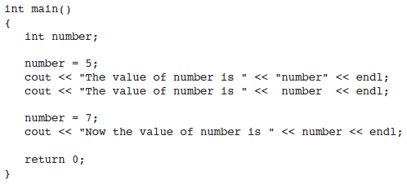

C++ Program with a variable
5 is an integer literal
This is a string literal
1. Variables, Constants, and Assignment Statements

Slide 19
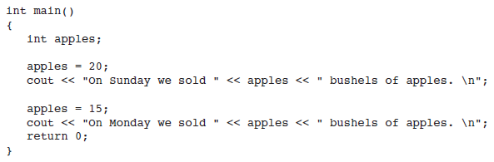
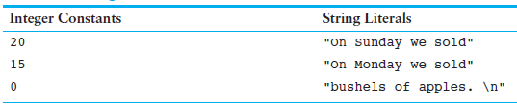
Constants
Unlike a variable, a constant is a data item whose value cannot change during the program’s execution
Following program contains integer constants, string constants (i.e., string literals), and a variable
1. Variables, Constants, and Assignment Statements

Slide 20
Chapter Overview
Variables, constants and assignment statements
Data types
Arithmetic operators
Input statement
Operator precedence

Slide 21
C++ Data Types
Data is information that can be stored and used by a computer program.
There are many different types of data.
Variables are classified according to their data type, which determines the kind of information that may be stored in them.
2. Data Types

Slide 22
C++ Data Types
There are 10 basic / primitive data types in C++.
Category | Type | Bytes
Integers | bool | 1
 | char | 1
 | int | 4
 | short | 2
 | long | 4
 | Unsigned int | 4
 | Unsigned short | 2
 | Unsigned long | 4
Fractional numbers | float | 4
 | double | 8
2. Data Types

Slide 23
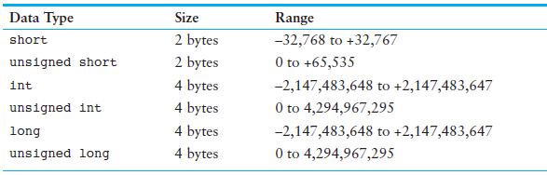

Integer Data Types Sizes & Ranges
The number of bytes is compiler dependent. Depending on your operating system, the sizes and ranges may be different. E.g. int 2 bytes for 16-bit systems (MS DOS)
Some integer variable definitions:
2. Data Types

Slide 24
Things to consider while using numeric data
Your primary considerations for selecting the best data type for a numeric variable are the following:
  Whether the variable needs to hold integers or floating-point values, the largest and smallest numbers that the variable needs to be able to store.
  Whether the variable needs to hold signed (both positive and negative) or only unsigned (just zero and positive) numbers.
  The number of decimal places of precision needed for values stored in the variable.
2. Data Types
2. Data Types

Slide 25
Defining Variables
Variables of the same type can be defined
  - On separate lines:
  int length;
  int width;
  unsigned int area;
  - On the same line:
  int length, width;
  unsigned int area;
Variables of different types must be in different definitions
2. Data Types

Slide 26
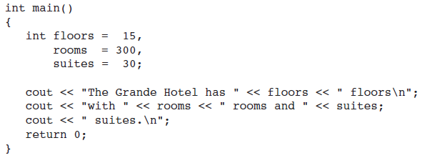

Program to demonstrate “INTEGER VARIABLES”
2. Data Types

Slide 27

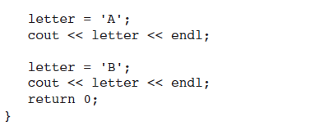

The char Data Type
A variable of the char data type holds only a single character.
2. Data Types

Slide 28
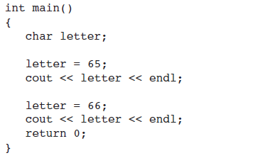
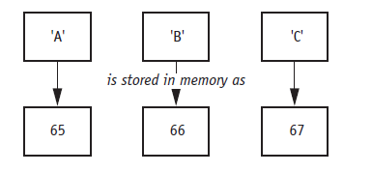

Relationship between characters & Integers
2. Data Types

Slide 29
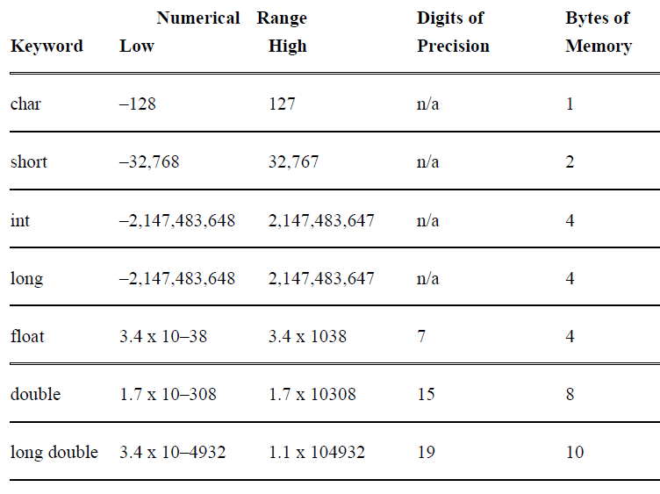
Signed Data Types
Note: The values of any of these may be different on your system.
2. Data Types

Slide 30
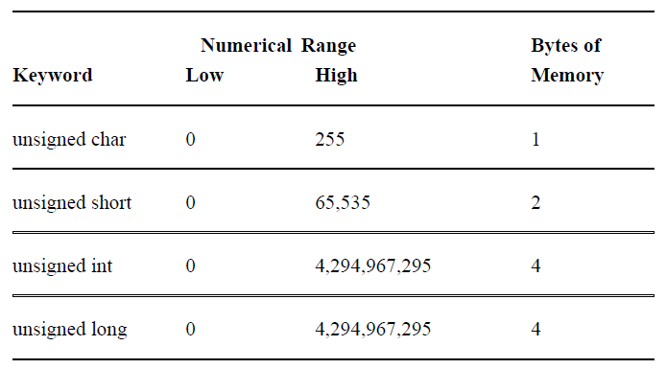
Unsigned Data Types
2. Data Types

Slide 31
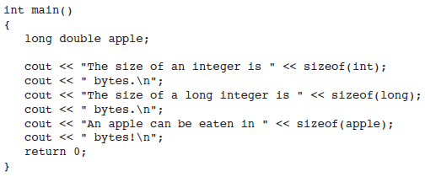
Determining the Size of a Data Type
The sizeof operator may be used to determine the size of a data type on any system.
2. Data Types

Slide 32
Chapter Overview
Variables, constants and assignment statements
Data types
Arithmetic operators
Input statement
Operator precedence

Slide 33
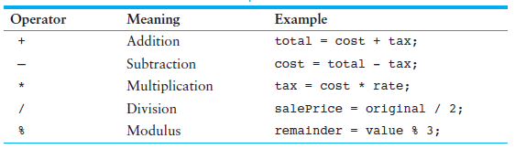
Fundamental Arithmetic Operators
Write a program to display the sum, difference, product, division and modulus of two numbers.
3. Arithmetic Operators

Slide 34
Arithmetic Operators
If the inputs of the division operation are both integers, the output will be truncated to an integer.
3. Arithmetic Operators

Slide 35
Chapter Overview
Variables, constants and assignment statements
Data types
Arithmetic operators
Input statement
Operator precedence

Slide 36
The Input Statement Using cin Object
cin >> variable ;
input object
Extraction Operator
- cin accepts data input from the console input like keyboard.
cin takes the value from the user at run time and stores it in the variable.
The syntax :
cin >> variable;
4. Input Statement

Slide 37
Input Example using cin
#include<iostream>
void main( ) {
clrscr();
int i; float j; char w;
cout<<“Enter value for i = ”;
cin>>i;
cout<<endl<<“Enter value for j = ”;
cin>>j;
cout<<endl<<“Enter value for w = ”;
cin>>w;
cout<<endl<<“The value you entered \
for i = “<<i<<endl<<“the value you \
entered for j = “<<j<<endl<<“the value\ you entered for w = “<<w;
}
OUTPUT
Enter value for i =
7
7
8
6
6
value of i =
8
65000
5.
5.
8
8
Enter value for j =
9
9
value of j =
100000
Enter value for w =
c
c
value of k =
543.77
The value you entered for i = 786
The value you entered for j = 5.89
The value you entered for w = c
value of l =
50000.897
value of m =
90000.8997
value of c =
w
j
i
w
4. Input Statement

Slide 38
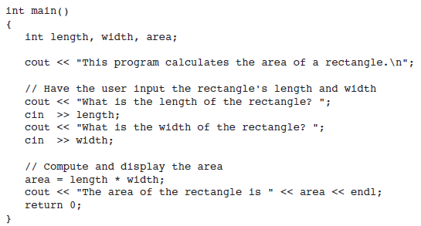
Program to take input from user
Stream extraction operator
4. Input Statement

Slide 39
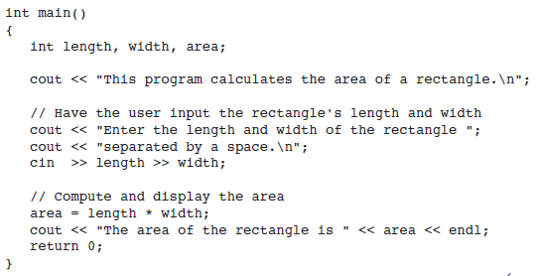
Entering Multiple Values
You can use cin to input multiple values at once.
4. Input Statement

Slide 40
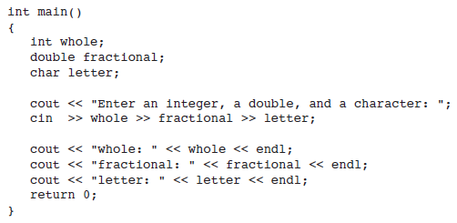

cin to read multiple values of different data types
4. Input Statement

Slide 41
Chapter Overview
Variables, constants and assignment statements
Data types
Arithmetic operators
Input statement
Operator precedence

Slide 42
Operator Precedence
Operator precedence describes the order in which C/C++ evaluates the expression?
It is possible to build mathematical expressions with several operators. The following statement assigns the sum of 17, x, 21, and y to the variable answer.
  answer = 17 + x + 21 + y;
Some expressions are not that straightforward, e.g.
  outcome = 12 + 6 / 3;
12 + 6 / 3
12 + 2
14
5. Operator Precedence

Slide 43
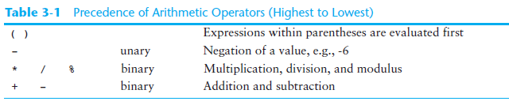
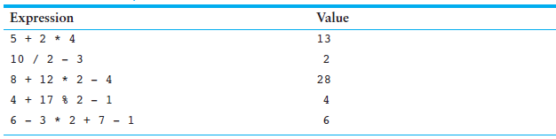
Precedence
5. Operator Precedence

Slide 44
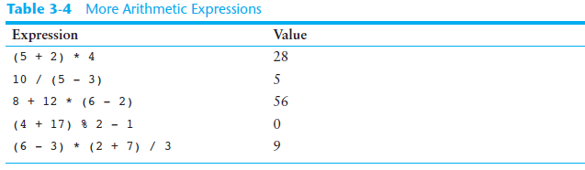
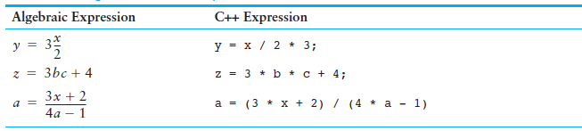
Arithmetic & Algebraic Expressions
5. Operator Precedence

Slide 45
References
  Problem Solving with C++ (10th Edition), Walter Savitch, Addison Wesley, 2018
  CS201 Introduction to Programming, Virtual University of Pakistan
  Paul J. Dietel, C++ How to Program (10th Edition), Pearson, 2017.
  Turbo C programming for the PC, Robert Lafore
  Dr. Kamran’s notes.
Compiled by Dr. Hew

